Slide 1


Concepts Supported by Programming Paradigms
Programming paradigms are different approaches to structuring and organizing code. Each paradigm focuses on different concepts, providing tools for developers to tackle various problems.
by Prathap Kumar K

Slide 2
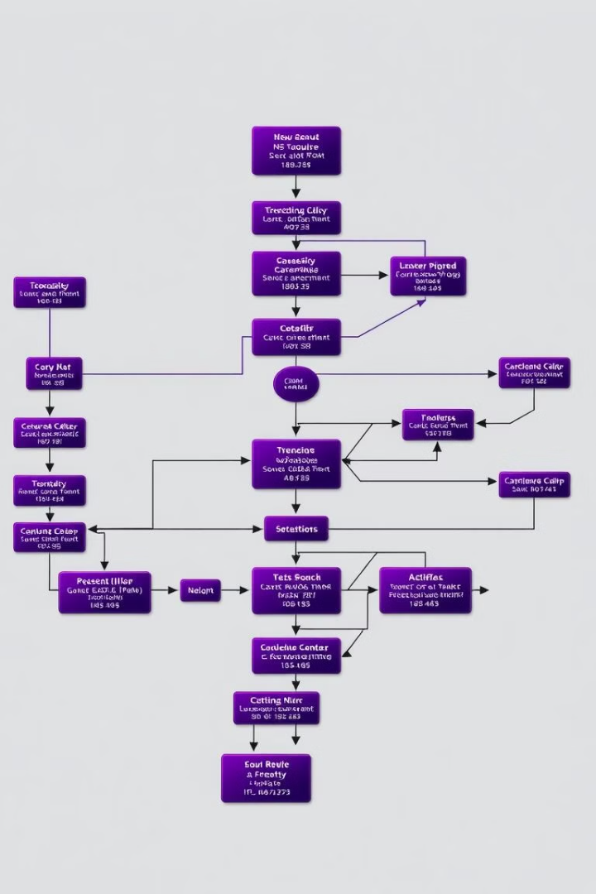
What is Procedural Programming?
Procedural programming is a paradigm that focuses on a sequence of steps. It relies on procedures or functions to perform specific tasks.
1
Sequential Execution
2
Data Manipulation
Focuses on manipulating data using functions and variables.
Code is executed line by line, following a defined order.
3
Global Scope
Data can be accessed and modified from anywhere within the program.

Slide 3
Fundamentals of Object-Oriented Programming
Object-oriented programming revolves around the idea of objects, which encapsulate data and behavior.
Encapsulation
Inheritance
Polymorphism
Hiding data and methods within an object, controlling access.
Creating new objects that inherit properties and methods from existing ones.
Ability to perform different actions based on the type of object.

Slide 4
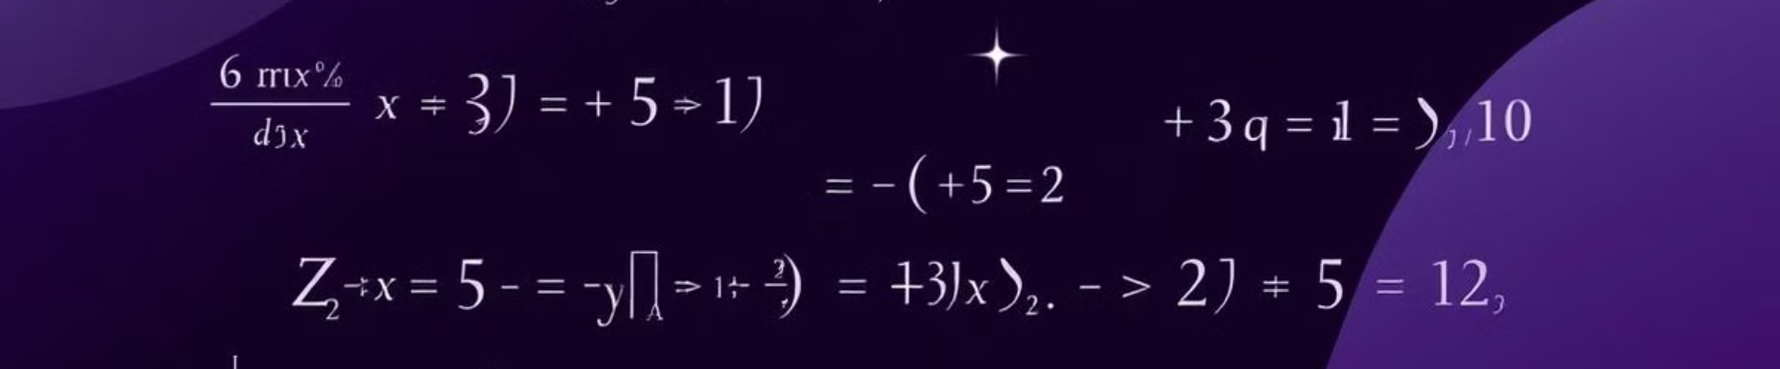
Key Principles of Functional Programming
Functional programming emphasizes the use of functions as building blocks, treating them as first-class citizens.
Immutability
Pure Functions
Higher-Order Functions
Data is considered immutable, preventing accidental changes.
Functions always return the same output for the same input, without side effects.
Functions can accept other functions as arguments or return functions as results.

Slide 5




Introduction to Aspect-Oriented Programming
Aspect-oriented programming (AOP) provides a modular way to handle cross-cutting concerns, separating them from the core business logic.
Cross-Cutting Concerns
Concerns that affect multiple parts of the program, like logging, security, or error handling.
Aspects
Modules that encapsulate cross-cutting concerns, applied to the main program.
Separation of Concerns
Enhances code organization and maintainability by separating core logic from secondary aspects.

Slide 6
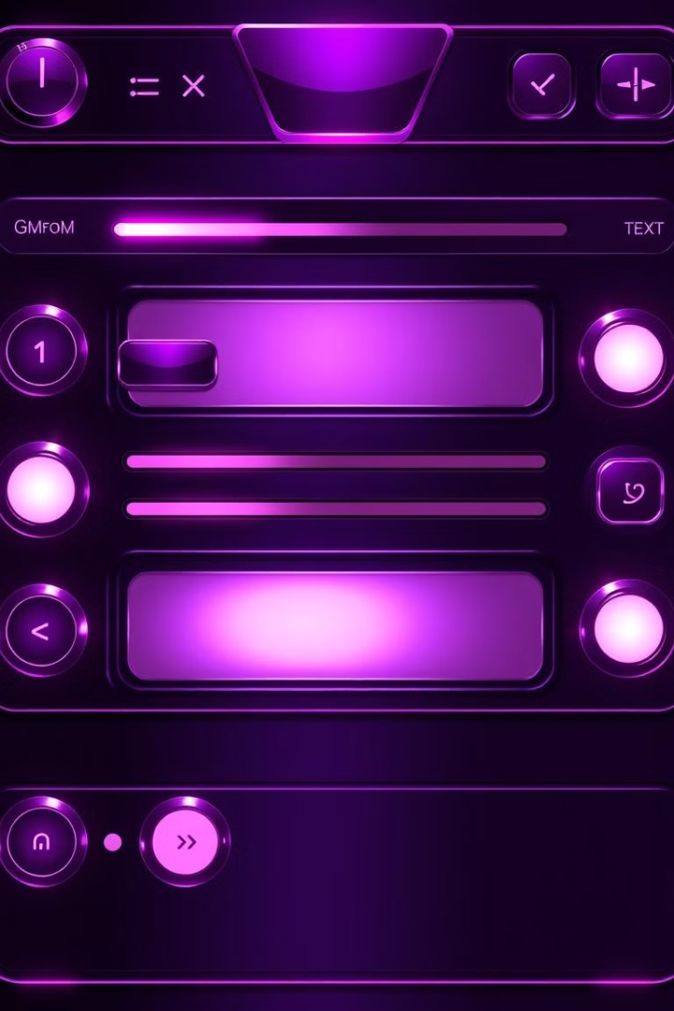
Event-Driven Programming in Action
Event-driven programming utilizes events, like user interactions or system changes, to trigger responses and actions.
1
Events
Actions or occurrences that trigger specific behavior within the program.
2
Event Handlers
Functions that respond to specific events, performing predefined actions.
3
Event Queue
A structure that stores events in the order they occur, ensuring order and response.

Slide 7
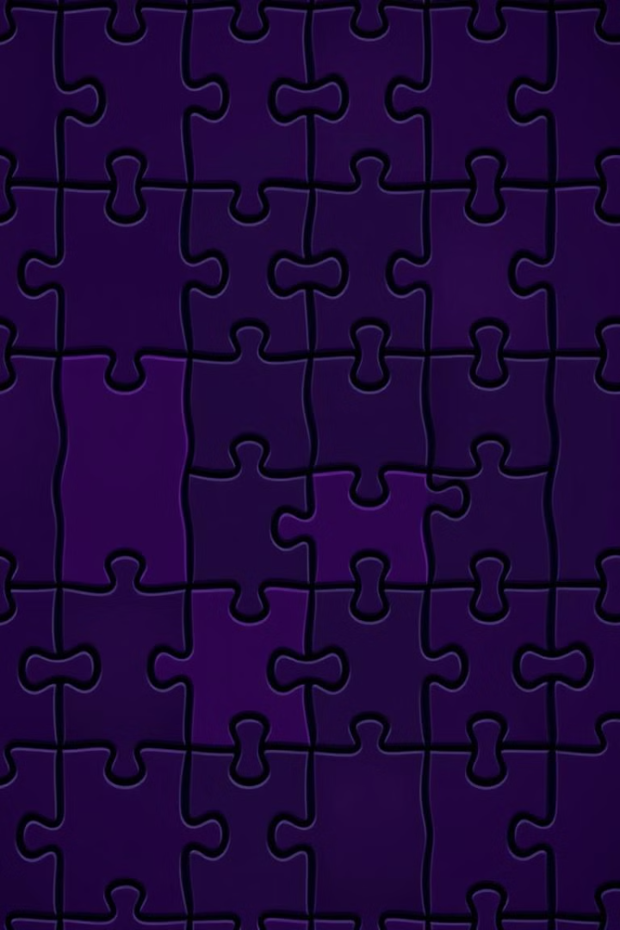
Combining Paradigms for Optimal Solutions
Combining multiple paradigms can leverage their strengths to create robust and efficient solutions.
Procedural
Object-Oriented
Functional
Aspect-Oriented
Event-Driven
Sequential execution
Encapsulation
Immutability
Cross-cutting concerns
Event-based actions
Functions
Inheritance
Pure functions
Aspects
Event handlers
Data manipulation
Polymorphism
Higher-order functions
Separation of concerns
Event queue

Slide 8





Advantages and Disadvantages of Each Paradigm
Each paradigm has strengths and weaknesses, influencing its suitability for specific projects.
Procedural
Object-Oriented
Functional
Aspect-Oriented
Simplicity, efficiency for linear tasks.
Code reusability, modularity, large projects.
Concurrency, immutability, error handling.
Modular cross-cutting concerns, clean code.
Event-Driven
Responsiveness, interactivity, user interfaces.

Slide 9
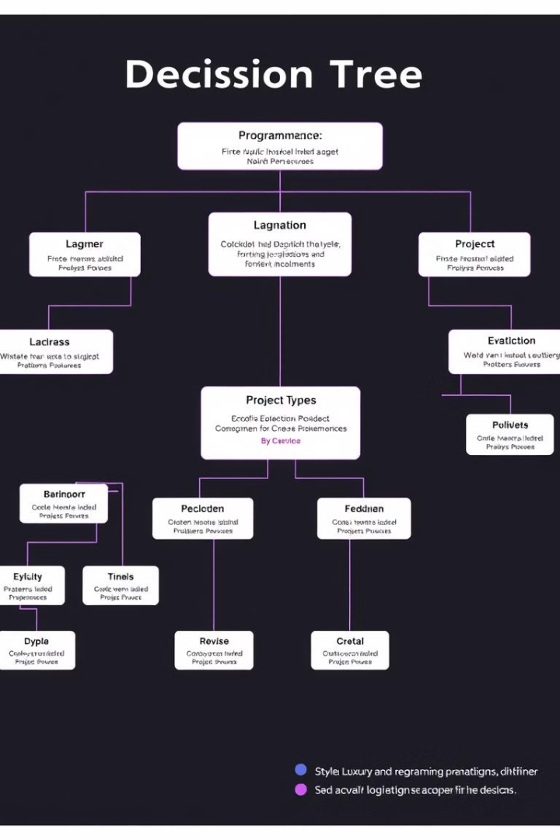
Choosing the Right Paradigm for Your Project
Selecting the right paradigm depends on the project's requirements, complexity, and goals.
1
Project Scope
2
Data Structure
Simple projects may benefit from procedural programming, while complex ones favor object-oriented.
Functional programming is well-suited for data transformations, while object-oriented excels in data representation.
3
Performance Requirements
Event-driven programming optimizes responsiveness, while functional programming offers concurrency.

Slide 10

Conclusion and Key Takeaways
Programming paradigms offer diverse approaches to software development, each with unique strengths and limitations.
Understanding Paradigms
Combining Paradigms
Adaptability
Familiarize yourself with different paradigms to choose the most appropriate for each project.
Don't hesitate to combine paradigms for optimal solutions, leveraging their strengths.
Embrace the flexibility of choosing the right paradigm to tackle different challenges effectively.

